Slide 1
Evently
Reem Mohamed 20120489 IS-6
Malak Medhat 20120396 IS-5
Yussuf Mohamed 20120460 IS-6
Mostafa nasser 20120389 IS-5
Nouran atef 20120434 IS-5

Slide 2
Overview
Evently Website

Slide 3
Objective
This software will make creating and scheduling events easier, and will reduce effort and time in inviting people to the event. Also it will document all the previous events which will make searching for the events easier than before.

Slide 4
Functional Requirements
Create Account
Edit Account
Create Event
Edit Event
Manage Event
Delete Event
Join Event
Buy Tickets
Leave Event
Create Stream
Follow Users
Receive Notifications
Suggest Events
Search for Different Events
Add Photos and videos

Slide 5
Non-Functional Requirements
Usability
Reliability
Performance
Supportability
Implementation
Interface
Legal
Availability
Maintainability
Recovery

Slide 6
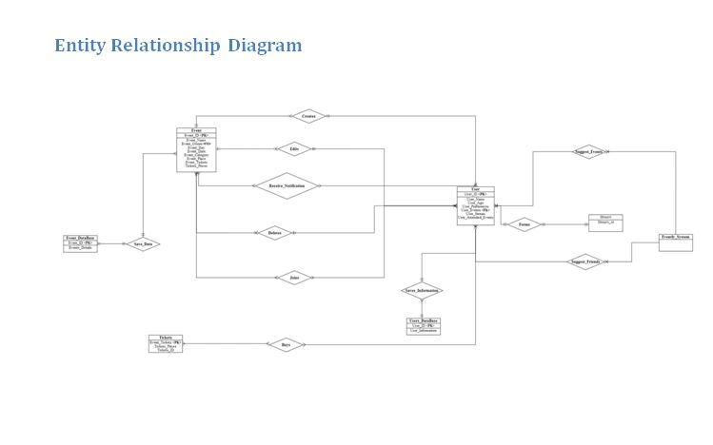
Designs

Slide 7
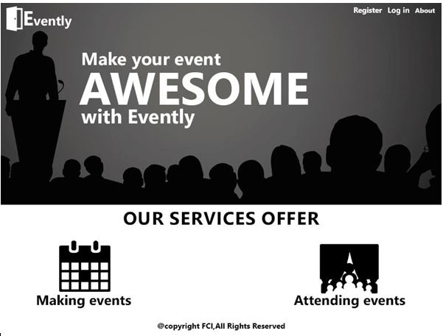
Designs

Slide 8
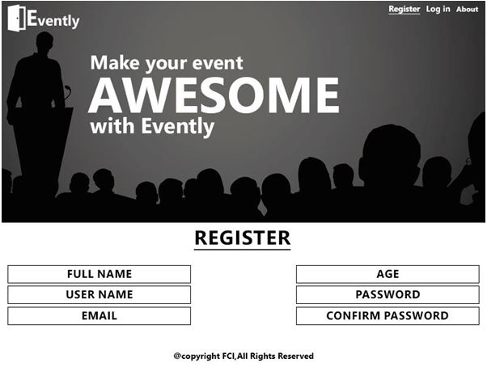
Designs

Slide 9
Implementation
Java Application , using Database connected to the code

Slide 10
Challenges and Difficulties
Connecting the database to the java application
Dividing the code to model , view , and control methods
Non-fixed errors

Slide 11
Lessons learned
New Design tools
New methods implemented in java
Using tools like github to share the work together
More tolerance while working in teams
Learning software engineering concepts

Slide 12
Next time
Develop a mobile application for our system
Better web design
Implement more functions and satisfy more requirements

